Slide 1
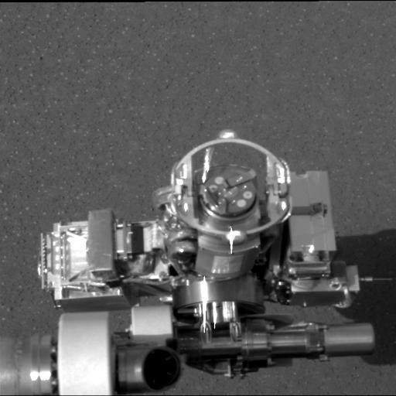
This image taken on Mars shows the rover's rock abrasion tool, also known as "RAT" (circular device in center), located on its instrument deployment device, or "arm." The “RAT” will grind away the outer surfaces of rocks to expose the rock interiors for examination.
Return to Menu Next Slide

Slide 2
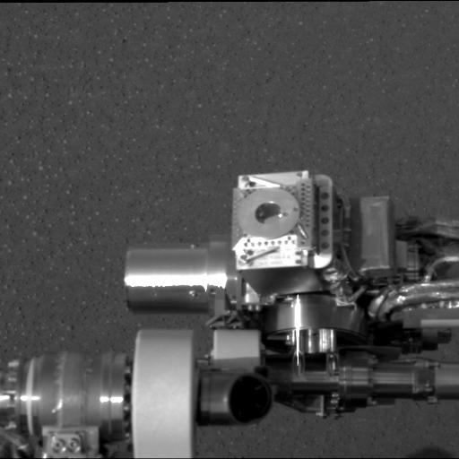
This image shows the rover's Mössbauer spectrometer (circular device in center), located on its instrument deployment device, or "arm." The Mössbauer spectrometer identifies minerals that contain iron. It will help scientists evaluate what role water played in the formation of the minerals.
Return to Menu Previous Slide Next Slide

Slide 3
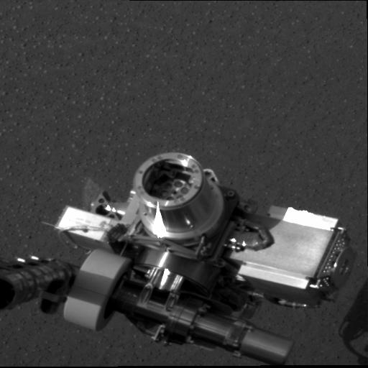
This image shows the rover's alpha particle X-ray spectrometer (circular device in center), located on its instrument deployment device, or "arm." The X-ray spectrometer measures the concentrations of most major elements in rocks and soils.
Return to Menu Previous Slide Next Slide

Slide 4
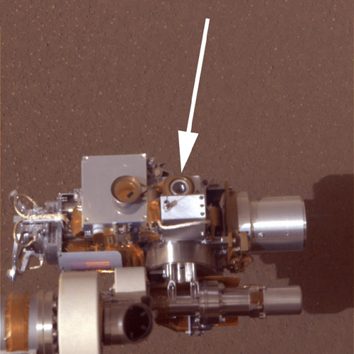
This image shows the rover's microscopic imager (circular device in center), located on its instrument deployment device, or "arm." The microscopic imager looks at the fine-scale appearance of rocks and soils.
Return to Menu Previous Slide

